Slide 1

What is cryptography?
Online Cryptography Course Dan Boneh
Introduction

Slide 2


Crypto core
Talking to Bob
Talking to Alice
Alice
Secret key establishment:
Secure communication:
Bob
attacker???
k
m₁
k
m₂
confidentiality and integrity

Slide 3

But crypto can do much more
Digital signatures
Anonymous communication
Alice signature
Who did I just talk to?
Alice
Bob

Slide 4

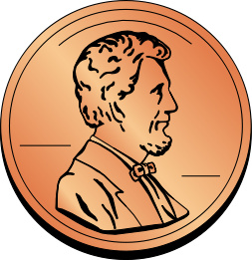
But crypto can do much more
Digital signatures
Anonymous communication
Anonymous digital cash
Can I spend a “digital coin” without anyone knowing who I am?
How to prevent double spending?
1$
Who was that?
Alice
Internet
(anon. comm.)

Slide 5

Protocols
Elections
Private auctions

Slide 6
Protocols
Elections
Private auctions
Secure multi-party computation
trusted authority
Goal: compute f(x₁, x₂, x₃, x₄)
“Thm:” anything the can done with trusted auth. can also be done without

Slide 7

Crypto magic
Privately outsourcing computation
Zero knowledge (proof of knowledge)
What did she search for?
search query
E[ query ]
Alice
E[ results ]
results
???
N=p∙q
Alice
I know the factors of N !!
proof π
N
Bob
Notes:
ZKPK: can be used for authentication

Slide 8
A rigorous science
The three steps in cryptography:
Precisely specify threat model
Propose a construction
Prove that breaking construction under threat mode will solve an underlying hard problem
Notes:
Example: define what it means to forge signatures, give construction, show that forging signatures is as hard as factoring.

Slide 9
End of Segment

